Slide 1
ONLINE MOVIE TICKET BOOKING SYSTEM
DONE BY:
M.SANJAY 220701246
B.RAGUNANDAN 220701211

Slide 2
ABSTRACT
The online movie ticket booking system is a web-based application designed to facilitate the process of reserving tickets for movies in theaters. This system aims to enhance user convenience by allowing moviegoers to browse movie listings, select preferred showtimes, and purchase tickets from the comfort of their homes or while on the go. The system provides a user-friendly interface with features such as real-time seat selection, secure payment gateways, and instant confirmation of bookings. Additionally, it offers theaters an efficient way to manage ticket sales, track bookings, and reduce administrative overhead. By integrating features like promotional offers, user reviews, and movie trailers, the system also aims to enrich the user experience and drive engagement. This abstract outlines the key functionalities and benefits of the online movie ticket booking system, emphasizing its role in modernizing the ticket purchasing process and improving overall customer satisfaction.

Slide 3
KEY FETAURES
1.MOVIE INFO:
1.MOVIE ID
2.MOVIE NAME
3.RELEASE DATE
4.DIRECTOR
5.CAST
6.BUDGET
7.DURATION
8.RATING OF THE MOVIE
2.MOVIE DETAILS

Slide 4
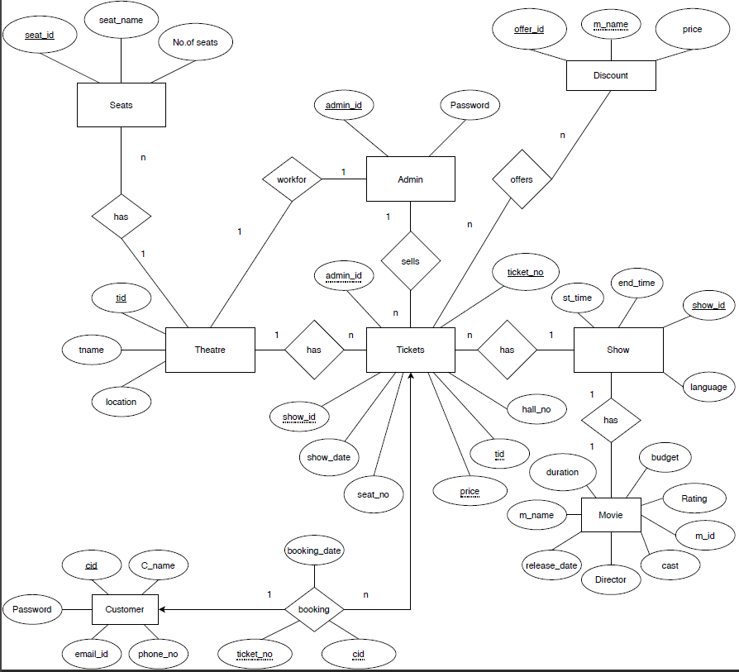
ENTITY RELATIONSHIP DIAGRAM

Slide 5
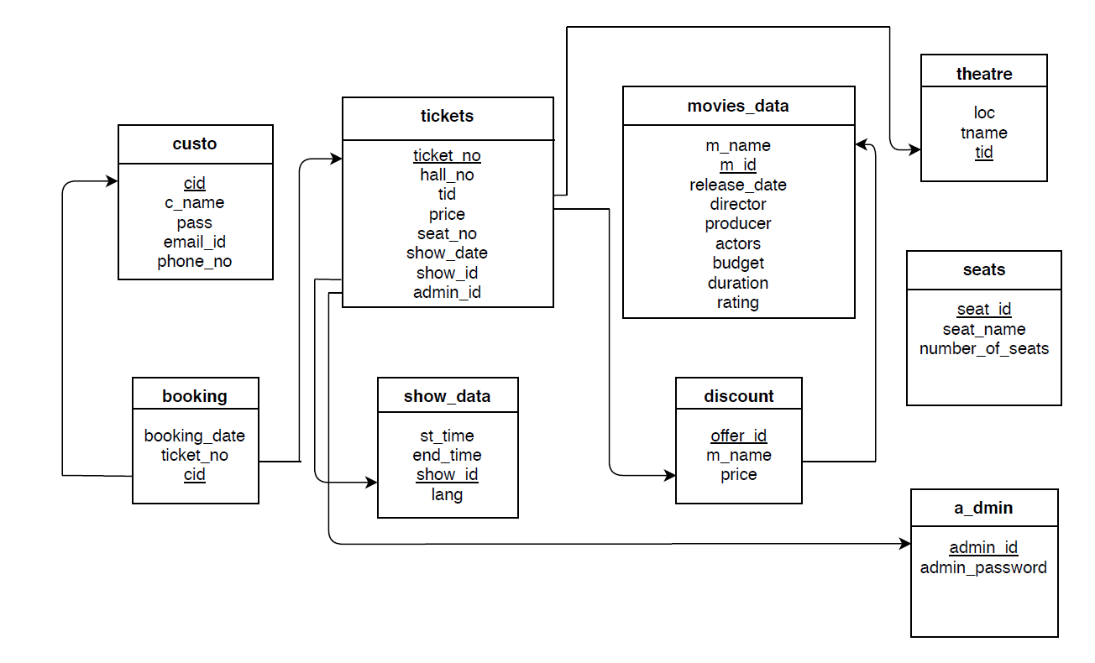
SCHEMA DIAGRAM

Slide 6
BACKEND SOURCE CODE
Import sqlite3
def MovieData():
con=sqlite3.connect("movie1.db")
cur=con.cursor()
cur.execute("CREATE TABLE IF NOT EXISTS book (id INTEGER PRIMARY KEY, Movie_ID text,Movie_Name text,Release_Date text,Director text,Cast text,Budget text,Duration text,Rating text")
con.commit()
con.close()
def AddMovieRec(Movie_ID,Movie_Name,Release_Date,Director,Cast,Budget,Duration,Rating):
con=sqlite3.connect("movie1.db")
cur=con.cursor()
cur.execute("INSERT INTO book VALUES (NULL, ?,?,?,?,?,?,?,?)", (Movie_ID,Movie_Name,Release_Date,Director,Cast,Budget,Duration,Rating))
con.commit()
con.close()
def ViewMovieData():
con=sqlite3.connect("movie1.db")
cur=con.cursor()
cur.execute("SELECT * FROM book")
rows=cur.fetchall()
con.close()
return rows

Slide 7
def DeleteMovieRec(id):
con=sqlite3.connect("movie1.db")
cur=con.cursor()
cur.execute("DELETE FROM book WHERE id=?", (id,))
con.commit()
con.close()
def SearchMovieData(Movie_ID="",Movie_Name="",Release_Date="",Director="",Cast="",Budget="",Duration="",Rating=""):
con=sqlite3.connect("movie1.db")
cur=con.cursor()
cur.execute("SELECT * FROM book WHERE Movie_ID=? OR Movie_Name=? OR Release_Date=? OR Director=? OR Cast=? OR Budget=? OR Duration=? OR Rating=?",(Movie_ID,Movie_Name,Release_Date,Director,Cast,Budget,Duration,Rating))
rows=cur.fetchall()
con.close()
return rows
def UpdateMovieData(id,Movie_ID="",Movie_Name="",Release_Date="",Director="",Cast="",Budget="",Duration="",Rating=""):
con=sqlite3.connect("movie1.db")
cur=con.cursor()
cur.execute("UPDATE book SET Movie_ID=?,Movie_Name=?,Release_Date=?,Director=?,Cast=?,Budget=?,Duration=?,Rating=?, WHERE id=?",(Movie_ID,Movie_Name,Release_Date,Director,Cast,Budget,Duration,Rating))
con.commit()
con.close()

Slide 8
FRONTEND SOURCE CODE
from tkinter import *
import tkinter.messagebox
import MiniProject_Backend
class Movie:
def __init__(self, root):
self.root=root
self.root.title("Online Movie Ticket Booking System")
self.root.geometry("1350x750+0+0")
self.root.config(bg="black")
Movie_Name=StringVar()
Movie_ID=StringVar()
Release_Date=StringVar()
Director=StringVar()
Cast=StringVar()
Budget=StringVar()
Duration=StringVar()
Rating=StringVar()
def iExit():
iExit=tkinter.messagebox.askyesno("Online Movie Ticket Booking System", "Are you sure???")
if iExit>0:
root.destroy()
return

Slide 9
def clcdata():
self.txtMovie_ID.delete(0,END)
self.txtMovie_Name.delete(0,END)
self.txtRelease_Date.delete(0,END)
self.txtDirector.delete(0,END)
self.txtCast.delete(0,END)
self.txtBudget.delete(0,END)
self.txtRating.delete(0,END)
self.txtDuration.delete(0,END)
def adddata():
if(len(Movie_ID.get())!=0):
MiniProject_Backend.AddMovieRec(Movie_ID.get(),Movie_Name.get(),Release_Date.get(),Director.get(),Cast.get(),Budget.get(),Duration.get(),Rating.get())
MovieList.delete(0,END)
MovieList.insert(END,(Movie_ID.get(),Movie_Name.get(),Release_Date.get(),Director.get(),Cast.get(),Budget.get(),Duration.get(),Rating.get()))
def disdata():
MovieList.delete(0,END)
for row in MiniProject_Backend.ViewMovieData():
MovieList.insert(END, row, str(""))
def movierec(event):
global sd
searchmovie=MovieList.curselection()[0]
sd=MovieList.get(searchmovie)
self.txtMovie_ID.delete(0,END)
self.txtMovie_ID.insert(END,sd[1])
self.txtMovie_Name.delete(0,END)

Slide 10
self.txtMovie_Name.insert(END,sd[2])
self.txtRelease_Date.delete(0,END)
self.txtRelease_Date.insert(END,sd[3])
self.txtDirector.delete(0,END)
self.txtDirector.insert(END,sd[4])
self.txtCast.delete(0,END)
self.txtCast.insert(END,sd[5])
self.txtBudget.delete(0,END)
self.txtBudget.insert(END,sd[6])
self.txtDuration.delete(0,END)
self.txtDuration.insert(END,sd[7])
self.txtRating.delete(0,END)
self.txtRating.insert(END,sd[8])
def deldata():
if(len(Movie_ID.get())!=0):
MiniProject_Backend.DeleteMovieRec(sd[0])
clcdata()
disdata()
def searchdb():
MovieList.delete(0,END)
for row in MiniProject_Backend.SearchMovieData(Movie_ID.get(),Movie_Name.get(),Release_Date.get(),Director.get(),Cast.get(),Budget.get(),Duration.get(),Rating.get()):
MovieList.insert(END, row, str(""))
def updata():
if(len(Movie_ID.get())!=0):
MiniProject_Backend.DeleteMovieRec(sd[0])
if(len(Movie_ID.get())!=0):

Slide 11
MiniProject_Backend.AddMovieRec(Movie_ID.get(),Movie_Name.get(),Release_Date.get(),Director.get(),Cast.get(),Budget.get(),Duration.get(),Rating.get())
MovieList.delete(0,END)
MovieList.insert(END,(Movie_ID.get(),Movie_Name.get(),Release_Date.get(),Director.get(),Cast.get(),Budget.get(),Duration.get(),Rating.get()))
#Frames
MainFrame=Frame(self.root, bg="black")
MainFrame.grid()
TFrame=Frame(MainFrame, bd=5, padx=54, pady=8, bg="black", relief=RIDGE)
TFrame.pack(side=TOP)
self.TFrame=Label(TFrame, font=('Arial', 51, 'bold'), text="ONLINE MOVIE TICKET BOOKING SYSTEM", bg="black", fg="orange")
self.TFrame.grid()
BFrame=Frame(MainFrame, bd=2, width=1350, height=70, padx=18, pady=10, bg="black", relief=RIDGE)
BFrame.pack(side=BOTTOM)
DFrame=Frame(MainFrame, bd=2, width=1300, height=400, padx=20, pady=20, bg="black", relief=RIDGE)
DFrame.pack(side=BOTTOM)
DFrameL=LabelFrame(DFrame, bd=2, width=1000, height=600, padx=20, bg="black", relief=RIDGE, font=('Arial', 20, 'bold'), text="Movie Info_\n", fg="white")
DFrameL.pack(side=LEFT)
DFrameR=LabelFrame(DFrame, bd=2, width=450, height=300, padx=31, pady=3, bg="black", relief=RIDGE, font=('Arial', 20, 'bold'), text="Movie Details_\n", fg="white")
DFrameR.pack(side=RIGHT)

Slide 12
#Labels & Entry Box
self.lblMovie_ID=Label(DFrameL, font=('Arial', 18, 'bold'), text="Movie ID:", padx=2, pady=2, bg="black", fg="orange")
self.lblMovie_ID.grid(row=0, column=0, sticky=W)
self.txtMovie_ID=Entry(DFrameL, font=('Arial', 18, 'bold'), textvariable=Movie_ID, width=39, bg="black", fg="white")
self.txtMovie_ID.grid(row=0, column=1)
self.lblMovie_Name=Label(DFrameL, font=('Arial', 18, 'bold'), text="Movie Name:", padx=2, pady=2, bg="black", fg="orange")
self.lblMovie_Name.grid(row=1, column=0, sticky=W)
self.txtMovie_Name=Entry(DFrameL, font=('Arial', 18, 'bold'), textvariable=Movie_Name, width=39, bg="black", fg="white")
self.txtMovie_Name.grid(row=1, column=1)
self.lblRelease_Date=Label(DFrameL, font=('Arial', 18, 'bold'), text="Release Date:", padx=2, pady=2, bg="black", fg="orange")
self.lblRelease_Date.grid(row=2, column=0, sticky=W)
self.txtRelease_Date=Entry(DFrameL, font=('Arial', 18, 'bold'), textvariable=Release_Date, width=39, bg="black", fg="white")
self.txtRelease_Date.grid(row=2, column=1)
self.lblDirector=Label(DFrameL, font=('Arial', 18, 'bold'), text="Director:", padx=2, pady=2, bg="black", fg="orange")
self.lblDirector.grid(row=3, column=0, sticky=W)
self.txtDirector=Entry(DFrameL, font=('Arial', 18, 'bold'), textvariable=Director, width=39, bg="black", fg="white")
self.txtDirector.grid(row=3, column=1)
self.lblCast=Label(DFrameL, font=('Arial', 18, 'bold'), text="Cast:", padx=2, pady=2, bg="black", fg="orange")
self.lblCast.grid(row=4, column=0, sticky=W)
self.txtCast=Entry(DFrameL, font=('Arial', 18, 'bold'), textvariable=Cast, width=39, bg="black", fg="white")
self.txtCast.grid(row=4, column=1)

Slide 13
self.lblBudget=Label(DFrameL, font=('Arial', 18, 'bold'), text="Budget (Crores INR):", padx=2, pady=2, bg="black", fg="orange")
self.lblBudget.grid(row=5, column=0, sticky=W)
self.txtBudget=Entry(DFrameL, font=('Arial', 18, 'bold'), textvariable=Budget, width=39, bg="black", fg="white")
self.txtBudget.grid(row=5, column=1)
self.lblDuration=Label(DFrameL, font=('Arial', 18, 'bold'), text="Duration (Hrs):", padx=2, pady=2, bg="black", fg="orange")
self.lblDuration.grid(row=6, column=0, sticky=W)
self.txtDuration=Entry(DFrameL, font=('Arial', 18, 'bold'), textvariable=Duration, width=39, bg="black", fg="white")
self.txtDuration.grid(row=6, column=1)
self.lblRating=Label(DFrameL, font=('Arial', 18, 'bold'), text="Rating (Out of 5):", padx=2, pady=2, bg="black", fg="orange")
self.lblRating.grid(row=7, column=0, sticky=W)
self.txtRating=Entry(DFrameL, font=('Arial', 18, 'bold'), textvariable=Rating, width=39, bg="black", fg="white")
self.txtRating.grid(row=7, column=1)
#ListBox & ScrollBar
sb=Scrollbar(DFrameR)
sb.grid(row=0, column=1, sticky='ns')
MovieList=Listbox(DFrameR, width=41, height=16, font=('Arial', 12, 'bold'), bg="black", fg="white", yscrollcommand=sb.set)
MovieList.bind('<<ListboxSelect>>', movierec)
MovieList.grid(row=0, column=0, padx=8)
sb.config(command=MovieList.yview)
#Buttons
self.btnadd=Button(BFrame, text="Add New", font=('Arial', 20, 'bold'), width=10, height=1, bd=4, bg="orange", command=adddata)
self.btnadd.grid(row=0, column=0)

Slide 14
self.btndis=Button(BFrame, text="Display", font=('Arial', 20, 'bold'), width=10, height=1, bd=4, bg="orange", command=disdata)
self.btndis.grid(row=0, column=1)
self.btnclc=Button(BFrame, text="Clear", font=('Arial', 20, 'bold'), width=10, height=1, bd=4, bg="orange", command=clcdata)
self.btnclc.grid(row=0, column=2)
self.btnse=Button(BFrame, text="Search", font=('Arial', 20, 'bold'), width=10, height=1, bd=4, bg="orange", command=searchdb)
self.btnse.grid(row=0, column=3)
self.btndel=Button(BFrame, text="Delete", font=('Arial', 20, 'bold'), width=10, height=1, bd=4, bg="orange", command=deldata)
self.btndel.grid(row=0, column=4)
self.btnup=Button(BFrame, text="Update", font=('Arial', 20, 'bold'), width=10, height=1, bd=4, bg="orange", command=updata)
self.btnup.grid(row=0, column=5)
self.btnx=Button(BFrame, text="Exit", font=('Arial', 20, 'bold'), width=10, height=1, bd=4, bg="orange", command=iExit)
self.btnx.grid(row=0, column=6)
if __name__=='__main__':
root=Tk()
datbase=Movie(root)
root.mainloop()

Slide 15
THANK YOU

